Slide 1
Unit 10 I’ve had
this bike for three years.
Section B 2a-2d
R·八年级下册

Slide 2
Learning objects
By the end of the class, you will be able to …
1. Learn curriculum words and useful expressions.
2. Acquire the strategy of getting information from
previous knowledge.
3. Talk about changes in your hometown and
develop a deep affection for your hometown.

Slide 3
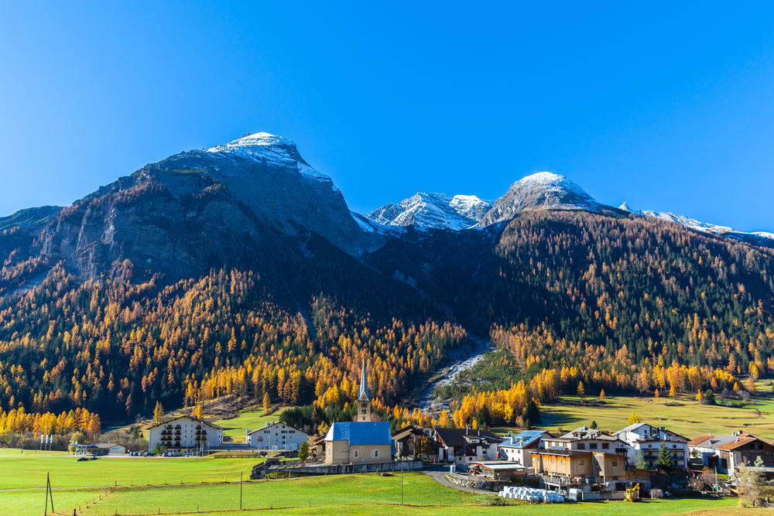

Enjoy a song

Slide 4
Brainstorm
What can you think of when hearing “hometown”?
a lot of hills
good/terrible weather
delicious food
friendly people
beautiful scenery
busy/clean streets
tall buildings
transportation
…

Slide 5

2a
Answer the questions before you read. Then read the passage to find out if your answers are the same as in the passage.
1. Why do millions of Chinese leave the
countryside every year?
2. How often do you think these people visit their
hometowns?
3. What new buildings does the government usually
build in towns and villages?
Tips: Using Previous Knowledge
We can often guess what a text is about by using what we already know. Answering questions before we read can also help us do this.

Slide 6
1. Why do millions of Chinese leave the countryside
every year?
2. How often do you think these people visit their
hometowns?
3. What new buildings does the government usually
build in towns and villages?
They leave the countryside to search/ look for work in the cities.
I think they visit their hometowns once or twice a year.
The government usually builds large hospitals and new schools in towns and villages.

Slide 7
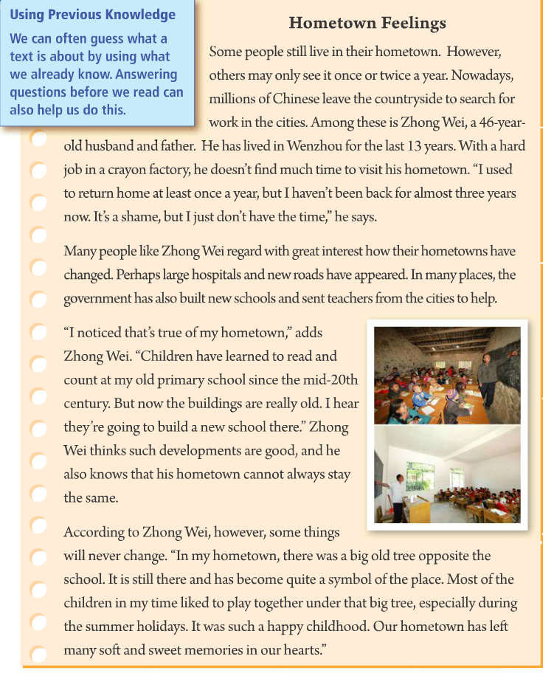

Fast reading
What’s the passage mainly talking about?
The changes in Zhong Wei’s hometown and his hometown feelings.
Task 1
Tips: pay attention to pictures, the title and key words appearing many times in the article.

Slide 8
Task 2: match the main idea with each paragraph
Para. 1 how their hometowns have changed
Para. 2 the people who leave their hometown
Para. 3 Some things will never change.
Para. 4 the changes of Zhong Wei’s hometown
Tips: the first sentence of a paragraph is usually the topic sentence.

Slide 9
Careful reading
Task 1: read Para. 1 and complete the information about Zhong Wei
Name: __________ Age: ____________
Role: _________________ City: _____________
Job: _______________________________________
Reason for leaving hometown: _______________________
How long he hasn’t been back: ___________________
Zhong Wei
46 years old
husband and father
Wenzhou
work in a crayon factory
search for work in cities
for almost three years

Slide 10
Task 2: read Para. 1 and answer
How often did Zhong Wei use to return home?
He used to return home at least once a year.
How does Zhong Wei feel about his hometown? Why?
He feels ashamed for not going back because he
just doesn’t have the time.

Slide 11


Task 3: read Paras. 2 & 3 and tick or cross
1. Many new schools and large hospitals have appeared
in Zhong Wei’s hometown.
2. The government has sent teachers from the cities to
help schools in Zhong Wei’s hometown.
3. Children have learned to read and count at Zhong
Wei’s old primary school since the mid-20th century.
4. Zhong Wei’s hometown always stays the same.

Slide 12
Task 4: read Paras. 2 & 3 and fill
The changes of hometown
new roads
Perhaps ______________and __________
have appeared.
large hospitals
Infrastructure
基础设施
In many places, the government built ____________and sent __________ from the cities _______.
new schools
teachers
Education
to help
Children have learned to _____________ at Zhong Wei’s old primary school.
read and count

Slide 13

Task 5: read Para. 4 and choose
What has become a symbol of Zhong Wei’s hometown?
A. A hospital. B. A big old tree. C. A school.
“Our hometown has left many soft and sweet memories in our hearts.” What does “left” mean?
A. 离开 B. 带走 C. 留下 D. 遗忘

Slide 14
What is Zhong Wei’s attitude towards these changes in his hometown?
A. Unsatisfied.
B. Indifferent.
C. Supportive with the feeling of nostalgy.
（怀旧的感觉）

Slide 15
Find expressions in the passage that have the same meanings as these words and phrases.
2b
1. look for _________ 5. go back ____________
2. consider ________ 6. changes _____________
3. across from ________ 7. area __________
4. in one’s opinion _____________
search for
return
regard
developments
opposite
place
according to sb.

Slide 16

Read and analyze
Hometown Feelings
Some people still live in their hometown. However, others may only see it once or twice a year. Nowadays, millions of Chinese leave the countryside to search for work in the cities.
search for意为“搜寻；寻找”。
拓展：search sb.意为“搜某人的身”；search＋地点 意为“搜查某地”；
search… for…意为“搜查……找……”；
in search of意为“寻找……”。
现今；现在；目前。通常用于一般现在时的句子中，且多用于句首或句末作状语。
不定式短语作目的状语

Slide 17
“一人两身份”，做主语的同位语
介词短语放在句首，句子完全倒装
Among these is Zhong Wei, a 46-year-old husband and father. He has lived in Wenzhou for the last 13 years. With a hard job in a crayon factory, he doesn’t find much time to visit his hometown. “I used to return home
在（三者或三者以上）之间

Slide 18
at least once a year, but I haven’t been back for almost three years now. It’s a shame, but I just don’t have the time,” he says.
可数名词，羞耻；羞愧；惭愧
it’s a shame 真遗憾；多可惜啊，可单独使用，也可接动词不定式或that从句。

Slide 19
Many people like Zhong Wei regard with great interest how their hometowns have changed. Perhaps large hospitals and new roads have appeared. In many places, the government has also built new schools and sent teachers from the cities to help.
how引导的宾语从句，作regard的宾语

Slide 20
“I noticed that’s true of my hometown,” adds Zhong Wei. “Children have learned to read and count at my old primary school since the mid-20th century. But now the buildings are really old. I hear they’re going to build a new school there.” Zhong Wei thinks such developments are good, and he also knows that his hometown cannot always stay the same.
拓展：count from… to… 从……数到……
count up to 数到……
count down 倒数
20世纪中期
拓展:“in the＋整十年份的复数形式”或“in the＋整十年份＋-’s”意为“在……世纪……年代”。

Slide 21
according to意为“依据；按照”，其中to是介词，其后可接名词、代词或从句。according to sb.意为“在某人看来；依某人之见”。
According to Zhong Wei, however, some things will never change. “In my hometown, there was a big old tree opposite the school. It is still there and has become quite a symbol of the place. Most of the children in my time liked to play together under that big tree, especially during the summer holidays. It was such a happy childhood. Our hometown has left many soft and sweet memories in our hearts.”
opposite作介词，意为“与……相对；在……对面”，相当于across from，常与名词一起构成介词短语，表方位。

Slide 22
Complete the summary with words from the passage. You may need to change the forms of the words.
2c
Many Chinese people these days leave their __________ to work in the ______. They usually ______ to their hometowns one or two times a _____. Zhong Wei hasn’t been back in close to three years. He has been working in a _______ factory in Wenzhou for the past 13 years.
hometowns
cities
return
靠近；接近
year
crayon

Slide 23
People like him are _________ in how their hometowns are changing. New buildings are often built by the ___________. Zhong Wei thinks these changes are _____ because things need to change in order to become better. But he also thinks some things _________ change, and his hometown is still the place that holds all his childhood _________.
interested
government
good
will never
memories

Slide 24
Passage structure
others may see hometown once or twice a year
Para. 1: The people who leave hometown
leave the countryside to search for work→live in Wenzhou for the last 13 years→doesn’t find much time→used to return home
→haven’t been back for almost three years→don’t have the time
how their hometowns have changes
large hospitals and new roads have appeared→built new school→sent teachers from the cities to help
Para. 2~3: The changes of hometown
the changes of Zhong Wei’s hometown
buildings are really old→going to build a new school→
developments are good→cannot always stay the same
some things will never change
Para. 4: Hometown feelings
there was a big old tree→become quite a symbol of the place→liked to play together→such a happy childhood
left many soft and sweet memories

Slide 25
Think of changes that are happening in your town or city today. Which changes are generally good? Which changes could be seen as bad?
2d

Slide 26
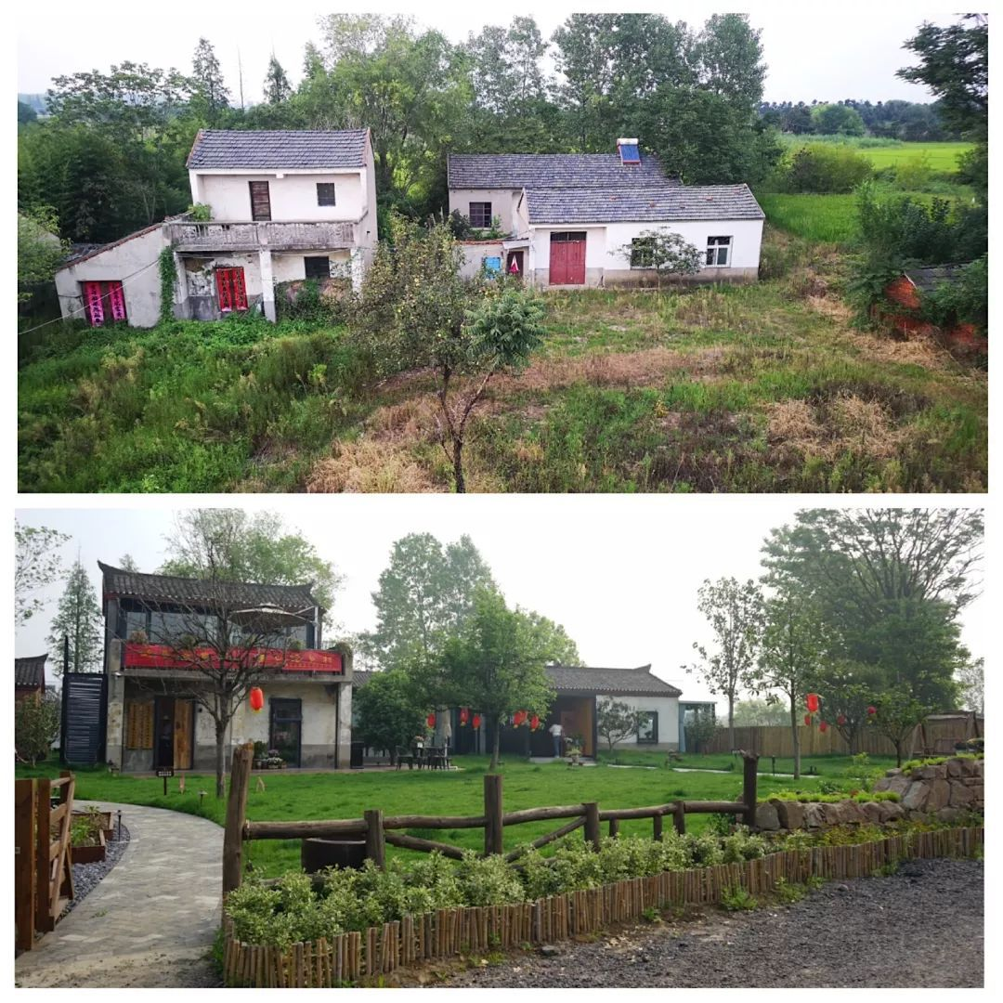
Houses become more beautiful and more convenient.

Slide 27
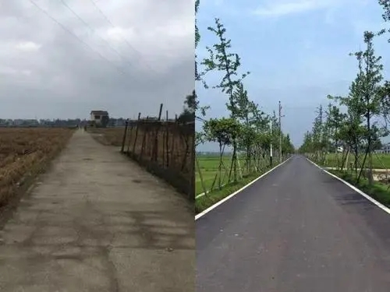
Roads become flatter（平坦的）, clearer and wider.

Slide 28
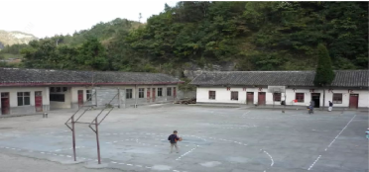
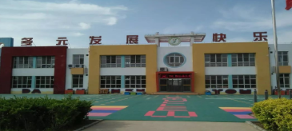
Schools become more beautiful and bigger.

Slide 29
Summary
Words and phrases:
nowadays search among crayon
shame regard count century
opposite especially childhood
consider hold search for
according to close to

Slide 30
Sentences:
Nowadays, million of Chinese leave the countryside to search for work in the cities.
Among these is Zhong Wei, a 46-year-old husband and father.
Children have learned to read and count at my old primary school since the mid-20th century.

Slide 31
According to Zhong Wei, however, some things will never change.
In my hometown, there was a big old tree opposite the school.

Slide 32
Homework
Recite the words, phrases and sentences in this part.
Read the passage again and retell it.
Do the exercises.（见“状元成才路”系列丛书《创优作业》对应课时作业）

