Slide 1
Unit 8 Have you read Treasure Island yet?
Section B 2a-2e
R·八年级下册

Slide 2
Learning objects（学习目标）
By the end of the class, you will be able to:
1. Learn the following key words and phrases:
forever, abroad, ever since, fan, southern, modern,
success, one another, laughter, beauty, record…
2. Learn how to use reading strategies to help us better
understand the text.
3. Develop the ability of summarizing.
4. Learn to write a short summary in your own words
after reading.

Slide 3
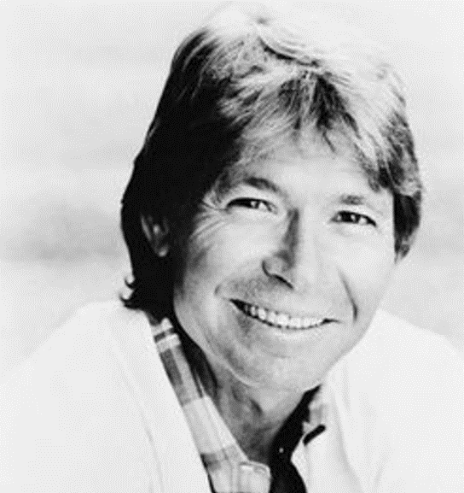

Watch and answer
Name:
Take me home, country roads
Singer:
John Denver
From:
the US
Kind:
country music
About:
the beauty of nature and the countryside
This song was his great success.

Slide 4



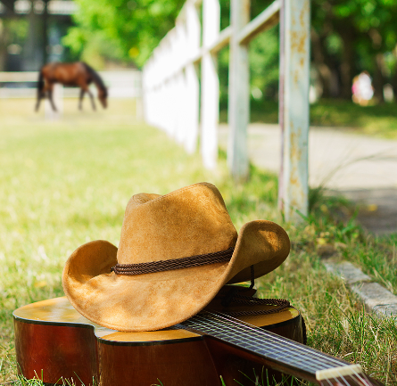
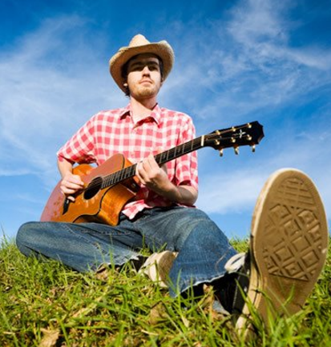
Which following aspects(方面) does the country music probably talk about?
Home
Success
Money
Friends
Nature
Fashion
…

Slide 5
2a
Discuss the questions with a partner.
Do you have a favorite singer or band?
2. Do you have a favorite song?
3. What facts do you know about your favorite
singer, band or song?

Slide 6
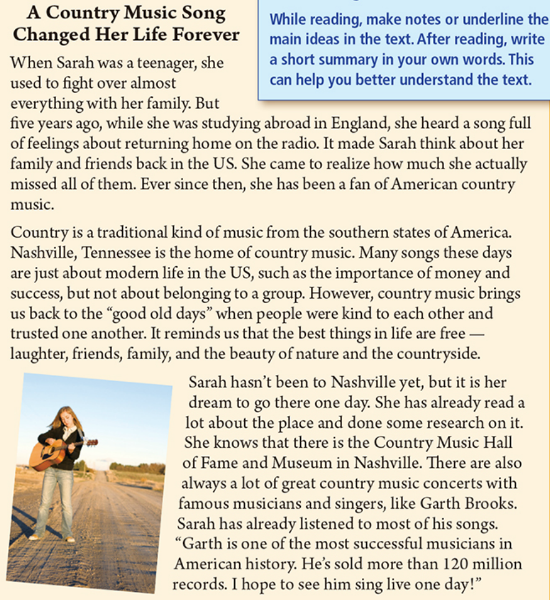

Pre-reading: Prediction
Look at the picture and the title of the passage. Try to predict:
1. What kind of music
does the girl like best?
She likes country
music best.
2. How has country music
changed her life?
Tips: Look at the title and picture, and predict what you will read about.
Maybe the music makes her calm down.

Slide 7

Fast reading
Read the passage quickly and get the general idea.
The general idea of the passage is about _______.
A. Sarah
B. a country music song changed Sarah’s life forever
C. country music

Slide 8
Read the passage and match each paragraph with the main idea.
Paragraph 1
Paragraph 2
Paragraph 3
Sarah’s dream
Sarah’s change
Country music
Tips: The topic sentence usually is the first or last sentence in each paragraph.

Slide 9
Careful reading
Read paragraph 1 and fill in the blanks.
Used to __________ almost everything _____________.
While she was ______________ in England, she heard a song _____________ about _______________.
She came to realize ___________ she actually ______
all of them.
She has been a fan of ______________________.
fight over
with her family
studying abroad
full of feelings
returning home
how much
missed
American country music

Slide 10
Read the passage and complete the fact sheet on page 63.
2b
Country Music Fact Sheet
Where it is from:__________________________ _________________________________________
What kind of music it is:____________________ _________________________________________ _________________________________________
the southern states of America, such as Nashville, Tennessee
a traditional kind of
music about belonging to a group, people being kind to each other and trusting one another

Slide 11
the number of ……的数量
the number of+可数名词复数，作主语时，谓语动词用单数形式。
a number of 许多；大量
a number of+可数名词复数，作主语时，谓语动词用复数形式。number前可加large, small, great等表示程度。
A famous country music place in Nashville: ___________________________________
A famous country music singer: ______________
The number of records he has sold:
______________________
Country Music Hall of Fame and Museum
Garth Brooks
more than 120 million

Slide 12
Read paragraph 2 and choose the right answers.
1. Country music is a _______ kind of music.
A. traditional B. modern
2. The home of country music is in _________.
A. England B. Nashville
3. Country music can bring people back to the good
______ and remind us the best things in life are ______.
A. old days; money B. present days; success
C. old days; free D. present days; music

Slide 13
Read paragraph 3 and answer the following questions.
1. What has Sarah done?
She has already read a lot about the place and done some research on it.
2. How many records has Garth sold?
He’s sold more than 120 million records.

Slide 14
Read the passage again and underline the main ideas.
2c

Slide 15
Then use the underlined text to write short answers to the questions below.
First paragraph
Who is Sarah?
Where is she from?
What does she like?
Sarah is a teenager who used to fight over almost everything with her family.
She is from the US.
American country music.

Slide 16
Second paragraph
What is country music?
What is country music about?
It is a traditional kind of music from the southern states of America.
It’s about belonging to a group and reminds us of a time when people were kind to each other and trusted one another.

Slide 17
Third paragraph
What is Sarah’s dream?
Who is Garth Brooks?
To go to Nashville one day.
Garth Brooks is a famous country singer who has sold more than 120 million records.

Slide 18

Let’s read. Pay attention to the following phrases and patterns.
abroad前不加冠词，也不能与in, at, to等介词连用，但可与from连用。
go abroad 出国
at home and abroad 在国内外
live abroad 住在国外
fight over 为……而争吵/打架
fight for 为……而战
fight with sb. 和某人打架
fight against 对抗…… ；反对……
A Country Music Song Changed Her Life Forever
When Sarah was a teenager, she used to fight over almost everything with her family. But five years ago, while she was studying abroad in England, she heard a song full of feelings about returning home on the radio. It made Sarah think about her family and friends back in the US. She came to realize how much she actually missed all of them. Ever since then, she has been a fan of American country music.
on the radio 通过收音机
on TV 通过电视
on the phone 通过电话
on line 在线
on the Internet 在网上
come to do sth. （事情）逐渐……；终于……
表示达到某种状态，常与know, understand, realize, be, love, like等动词连用，强调渐变过程。
ever since 自从，相当于since, ever起强调作用。其后接表示过去的时间点，可以是单词、短语或从句，句子或主句通常用现在完成时。
a fan of ……迷

Slide 19
belong to 属于；归……所有，不用于被动语态，也不用于进行时。
to为介词，后接名词或人称代词的宾格形式，不能接名词性物主代词或名词所有格。
belong to＋名词/人称代词宾格= be＋名词所有格/名词性物主代词
Country is a traditional kind of music from the southern states of America. Nashville, Tennessee is the home of country music. Many songs these days are just about modern life in the US, such as the importance of money and success, but not about belonging to a group. However, country music brings us back to the “good old days” when people were kind to each other and trusted one
another. It reminds us that the best things in life are free—
laughter, friends, family, and the beauty of nature and the countryside.
success n. 成功
succeed v. 成功
successful adj. 成功的
successfully adv. 成功地
one another= each other 互相，常作动词或介词的宾语。one another与each other的所有格均是在其后加-’s。
be kind to sb. =
be friendly to sb.
对某人友好
when引导的定语从句，修饰good old days
that引导的宾语从句，作remind的宾语
beauty n. 美；美丽
beautiful adj. 美丽的；美好的
beautifully adv. 漂亮地；美好地

Slide 20
Sarah hasn’t been to Nashville yet, but it is her dream
to go there one day. She has already read a lot about the place and done some research on it. She knows that there is a Country Music Hall of Fame Museum in Nashville. There are also always a lot of great country music concerts with famous musicians and singers, like Garth Brooks. Sarah has already listened to most of his songs. “Garth is one of the most successful musicians in American history. He’s sold more than 120 million records. I hope to see him sing live one day!”
have/has been to＋地点名词 去过某地
表示现在已不在那里了。当表示地点的词为副词时，则省略to。
不定式短语是真正的主语
it作形式主语
one day指将来或过去的某一天
用于表示将来或过去的句子中
some day指将来的某一天
用于表示将来的句子中
hope表示可以实现的希望
hope to do sth. 希望做某事 不能用hope sb. to do sth.
hope+(that) 从句 希望……
wish表示某种强烈的愿望或难以实现的愿望
wish to do sth. 希望做某事
wish sb. to do sth. 希望某人做某事
wish+(that) 从句 希望……
wish+宾语+宾语补足语（形容词或名词）表示美好的祝愿
与具体的数字连用时，表示确切的数目，其后不加-s，而且不与of连用。
当表示概数时，前面没有具体数字，其后加-s，而且要与of连用。
与million用法类似的词还有hundred, thousand, billion(十亿)。
record n. 唱片；记录
break a record 打破纪录
hold/keep a record 保持纪录
set a record 创造纪录
record v. 录制；录（音）
live
adv. 在现场直播
adj. 活的；有生命的；活生生的，只作定语
v. 居住；生活；过……生活

Slide 21
Translate the phrases into Chinese.
1. fight over sth. with sb.
2. on the radio
3. came to realize
4. ever since
5. a fan of
6. do some research on sth.
7. belong to
8. the importance of
为某事与某人争吵
通过收音机
逐渐意识到
自从
……迷
对……做了一些研究
属于；归……所有
……的重要性

Slide 22
Use the notes you made in 2c to write a short summary of the passage. Write no more than 100 words.
2d
Summarizing
While reading, make notes or underline the main ideas in the text. After reading, write a short summary in your own words. This can help you better understand the text.

Slide 23
Possible answer
Sarah is an American girl who used to fight over almost everything with her family. While she was studying in England, she heard a country music song which made her think of her family and friends. She became a fan of country music. Country is a traditional kind of music from the southern states of America. It is about belonging to a group and reminds us of a time when people were kind to each other and trusted one another. Sarah’s dream is to visit Nashville, and she hopes to see Garth Brooks sing live one day.

Slide 24
Close your book. What facts can you remember about country music? Tell a partner. What other facts would you like to know about country music? Make a list of questions.
2e

Slide 25
Close your book and fill in the blanks.
Country is a __________ kind of music from the southern states of America. Nashville, Tennessee is the ______ of country music. Many songs these days are just _______ modern life in the US, such as the ___________ of money and success, but not about belonging ____ a group.
traditional
home
about
importance
to

Slide 26
brings
However, country music _______ us back to the “good old days” when people were ______ to each other and trusted ____ _______. It ________ us that the best things in life are _____ — laughter, friends, family, and the beauty of nature and the countryside.
kind
one
another
reminds
free

Slide 27
Try to retell
A Country Music Song Changed Her Life Forever
a teenager: used to fight over almost everything with her family
five years ago: studying abroad
heard a song
Para. 1:
Sarah
think about her family and friends
missed all of them
now: has been a fan of American country music
where: … a traditional kind of… from the southern states of America
the home of
Para. 2: Country music
many song: about modern life
important of money and success
topic
not about belonging to a group
country music: bring us back to the “good old days”
effect: reminds
the best things
free
Country Music Hall of Fame and Museum
Para. 3: Sarah’s dream
go to Nashville: read a lot
done some research
country music concerts
like Garth Brooks
hope to see him sing live
the most successful
more than 120 million records

Slide 28
Discussion
Had you heard of country music before reading this passage?
What have you learned about country music from the article?
Have you heard of Garth Brooks?
Are you interested in country music?

Slide 29
Summary
Words & Phrases:
forever, abroad, ever since, fan, southern, modern,
success, one another, laughter, beauty, record…
Sentences:
When Sarah was a teenager, she used to fight over almost everything with her family.
Sarah hasn’t been to Nashville yet, but it is her
dream to go there one day.
Garth is one of the most successful musicians in American history.

Slide 30
Homework
1. Review the key words, phrases and sentences.
2. Read the passage and try to retell it to your parents.
3. What other facts would you like to know about
country music? Try to find answers by yourselves.
4. Do the exercises.（见“状元成才路”系列丛书
《创优作业》对应课时作业）

