Slide 1

Unit 12 What did you do last weekend?
Section B 3a-Self check
R·七年级下册

Slide 2
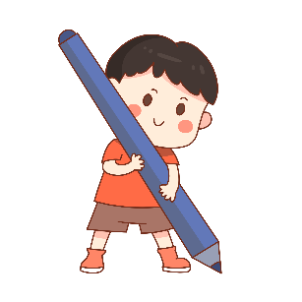
Learning objectives
1. Be able to write a passage about activities you
did last weekend.
2. Use the past forms to write a story.
3. Grasp the writing method of narration in a
timeline.
按时间叙述

Slide 3
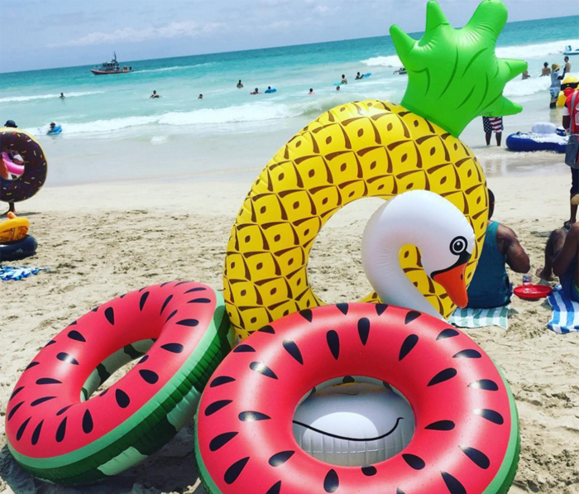
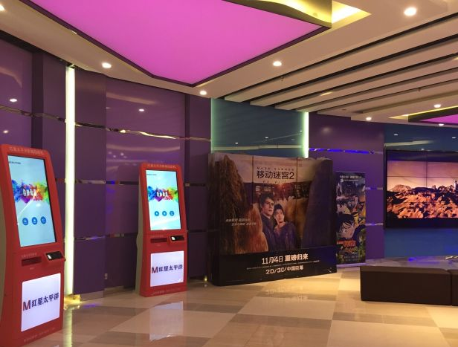
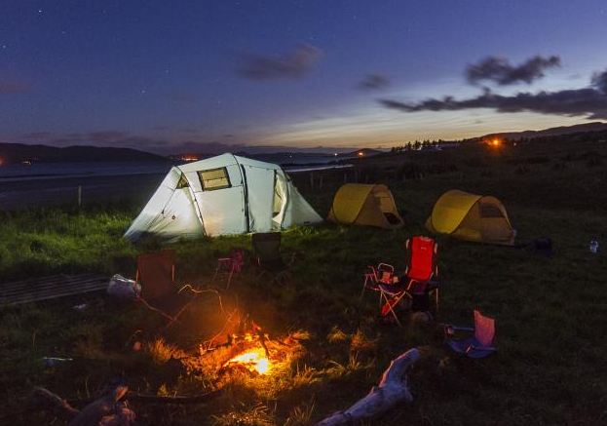
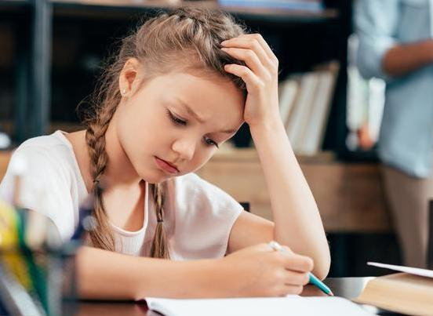
Review
Ask and answer
How was your last weekend?
Where did you go?
Who did you go with?
What did you do?

Slide 4
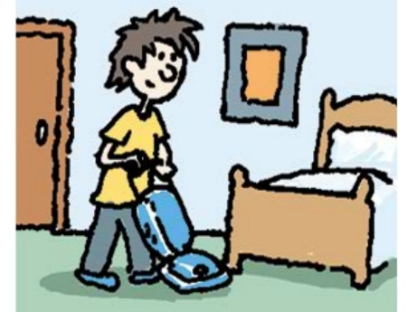
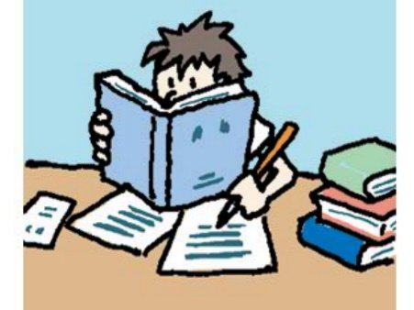
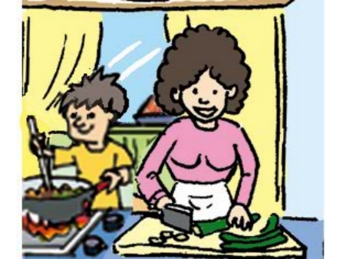
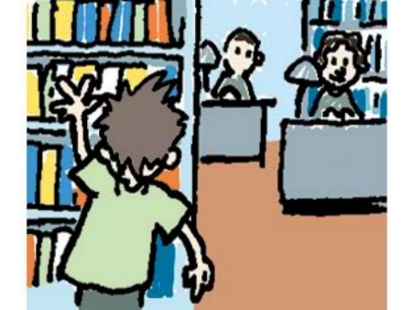
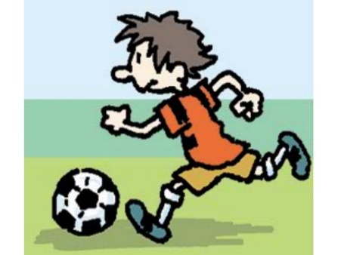
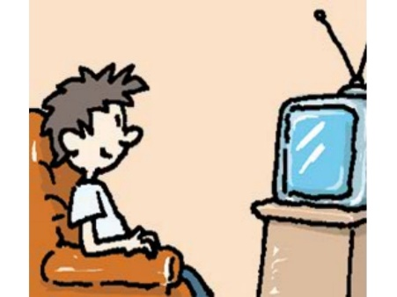
Look at my weekend. What do you think of my weekend? What did I do last weekend?
Saturday
Sunday

Slide 5



What did I do last Saturday?
cooked dinner
cleaned the room
did my homework

Slide 6



What did I do last Sunday?
watched TV
went to the library
played soccer

Slide 7






3a
Look at the pictures and complete the passage.
Saturday
Sunday

Slide 8
I had a busy weekend. On Saturday morning, I cleaned my room. In the afternoon, I ________________. It was a little difficult. On Saturday night, I stayed at home and ________________ cook dinner.
did my homework
helped my mother

Slide 9
On Sunday morning, I ________________. I read a book about history. Then in the afternoon, I ____________ with my friends. On Sunday night, I ___________. I saw an interesting talk show.
went to the library
played soccer
watched TV

Slide 10
Attention: The structure of the passage.
主题句
I had a ______weekend.
On Saturday morning, _____________.
In the afternoon, __________________.
On Saturday night, ________________.
On Sunday morning, _______________.
In the afternoon, ___________________.
On Sunday night, __________________.
The topic sentence gives the main idea of the paragraph. Other sentences give details.
细节句
时间先后顺序

Slide 11
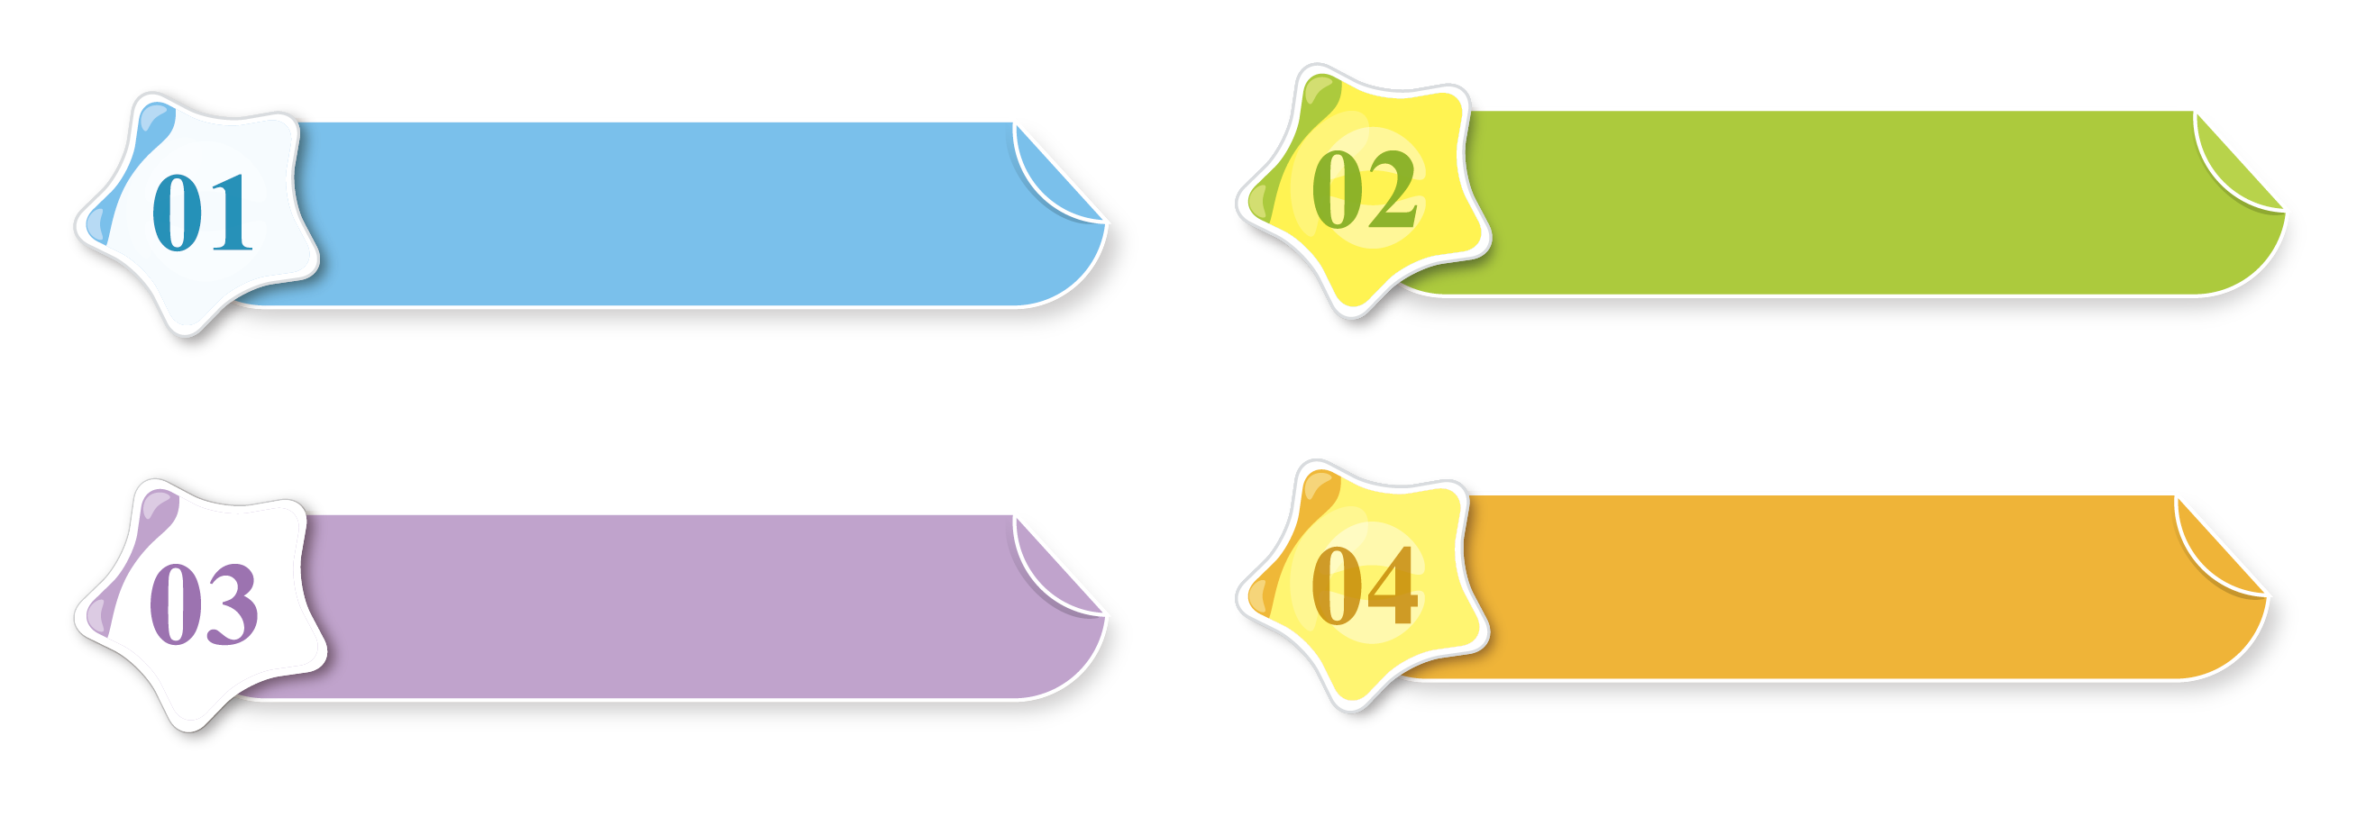
Writing
3b
Write about what you did last weekend.
话题概述
本单元的话题是“周末活动”,要求能围绕这一话题谈论自己或者他人周末的活动。在写作时,要能正确使用一般过去时来具体描写周末进行的各种活动,最后谈谈自己对周末生活的感受。

Slide 12
经典例题
请根据表格提示，以“My Last Weekend”为题写一篇英语短文，简单介绍一下你上周末的活动。
要点
时间 | 星期六 |  |  | 星期日
 | 上午 | 下午 | 晚上 | 上午 | 下午
活动 | 和父母去湖边野营，搭帐篷 | 划船，放风筝 | 生火，聊天，在帐篷睡觉 | 写家庭作业 | 打扫房间

Slide 13
要求:
1.短文必须包含所有提示内容，可适当发挥，
使文章内容通顺、完整。
2.70词左右。
体裁：
记叙文
审题
时态：
一般过去时
人称：
第一人称

Slide 14
谋篇布局
开门见山
I had…weekend. /It was…
Topic sentence
On Saturday morning, I…
In the afternoon, we…
In the evening, we…
On Sunday morning, we…
In the afternoon, I …
具体活动
detail sentences
表达感受
What a/an…weekend I had!

Slide 15
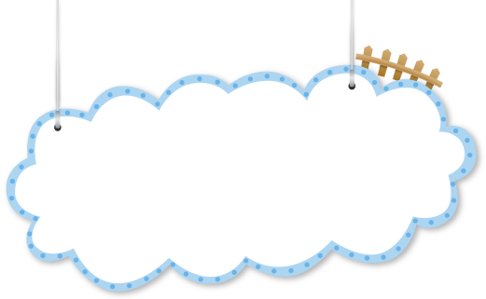

积句成篇
短语储备
stay up late 熬夜
fly a kite 放风筝
put up 搭起;举起
get a surprise 吃惊
wake... up 把……弄醒
by the lake 在湖边
go to the beach 去海滩

Slide 16
go boating 去划船
play badminton 打羽毛球
study for 为……而学习
do one’s homework 做作业
enjoy oneself 过得愉快
make a fire 生火
the next morning 第二天早上
each other 互相；彼此

Slide 17
开头句：
l had a busy weekend.我有一个忙碌的周末。
You asked me about my life on weekends. Now let me tell you something about it.你问我关于我周末的生活。现在让我来告诉你一些关于它的事情。
The weather was..., so I went to... with ...
天气……所以我和……去了……

Slide 18
中间句：
On Saturday morning/ afternoon/ evening, I...
星期六上午/下午/晚上,我……
The next day, I... 第二天,我……
I had a great time playing... with...
我和……玩得很开心。
It was great fun! 那非常有趣!
I was so tired that I went to sleep early.
我太累了,所以早早地去睡觉了。

Slide 19
结尾句：
All in all, we had a good day.
总之,我们度过了美好的一天。
We were a little tired, but we were very...
我们有点累,但是我们非常……
What a busy weekend l had!
我度过了一个多么忙碌的周末啊!
How interesting ! 多么有趣啊!

Slide 20
The last weekend
It was sunny and a little windy last weekend. On Saturday morning, I went camping with my parents by the lake. We put up a tent there. In the afternoon, we went boating and flew a kite. In the evening, we made a fire and talked with each other happily. Then we slept in the tent. It was great fun! On Sunday morning, we
范文欣赏

Slide 21
went home and I did my homework. In the afternoon,
I cleaned my room. In the evening, I was so tired that
I went to sleep early.
What a busy weekend I had!

Slide 22
限时演练
Make a form about your last activity weekend. Then write an article within 15 minutes.
时间 | 星期六 |  |  | 星期日
 | 上午 | 下午 | 晚上 | 上午 | 下午 (晚上)
活动

Slide 23
写短文，和同桌交换互评，参照如下：
1) Did he/she write in a timeline?
2) Did he/she use the past tense?
3) Did he/she use the past forms of the verbs correctly?
4) Did he/she write about his/her feelings?
5) Is there a topic sentence?
6) Are there any spelling mistakes?
7) Is his/her handwriting good?

Slide 24
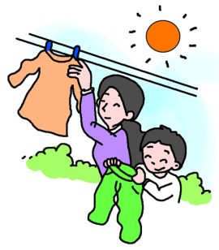

A possible version
My last weekend was kind of busy. I ________________
on Saturday morning. On Saturday afternoon,
I _________________ . I read a book there.
washed my clothes
went to the library

Slide 25
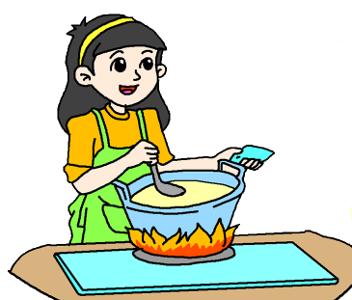

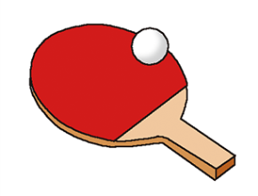
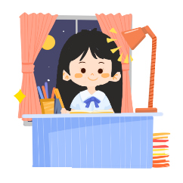
I _____________ in the evening. On
Sunday morning, I _________________ .
On Sunday afternoon, I ________________ .
On Sunday evening, I ________________ .
What a busy day I had!
cooked dinner
used the computer
played ping-pong
did my homework

Slide 26
Self Check
Complete the phrases. Then use some of them in the past forms to write a story.
_______ out with friends _______ for a walk _______ apples _______ photos | fly a _______ milk a _______
 | camp _______ the lake study _______ a test
go
kite
go
cow
pick
by
take
for

Slide 27

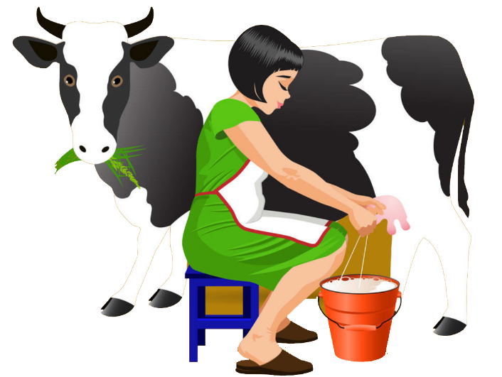
Activity
Make up sentences according to the pictures.
Last weekend, I ______________.

Slide 28







Slide 29
Complete the conversation.
A: I had a school trip last week.
B: Really. ________________ (go)?
A: I visited the fire station.
B: ___________________ (go with)?
A: I went with my classmates.
Where did you go
Who did you go with

Slide 30
B: _______________ (do)?
A: We watched the firefighters work. What an
interesting job they have!
B: _____________________ (learn anything)?
A: Sure. We learned how to call the fire station
and what to do when there is a fire.
What did you do
Did you learn anything

Slide 31

Summary
写作话题
周末活动，描述过去发生的事情
体裁/时态
记叙文/ 一般过去时
引入话题→具体介绍(按照时间先后顺)→总结（表达感受）
写作思路

Slide 32
Homework
1. Recite the key expressions in this unit.
2. Write a passage about your last weekend.
3. Do the exercises.（见“状元成才路”系列丛书
《创优作业》对应单元作业）

